Slide 1




Pandas DataFrames
Data analysis and manipulation for machine learning

Slide 2


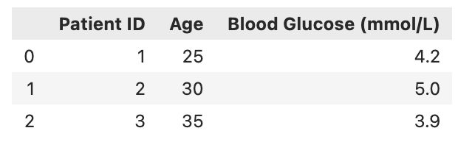



What is Pandas?
Pandas is a Python library for data manipulation and analysis, built on top of NumPy.
It is essential for data pre-processing and machine learning.
It has built-in tools for:
Pandas presents data in a tabular format called a DataFrame
Data cleaning
Data engineering
Data analysis

Slide 3
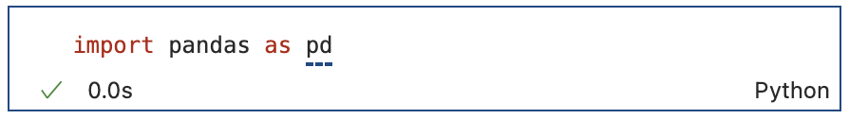
Importing Pandas
As with NumPy, in every Jupyter Notebook or Python script where you use pandas, you will need to install it as follows:

Slide 4

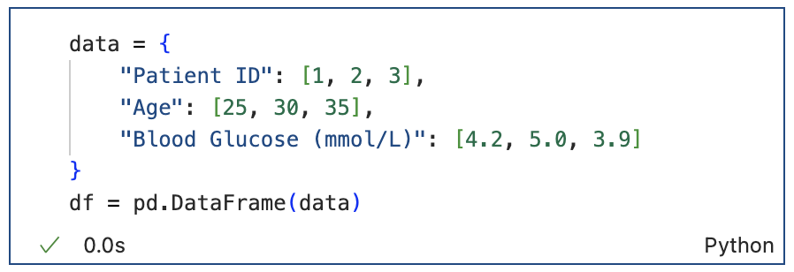
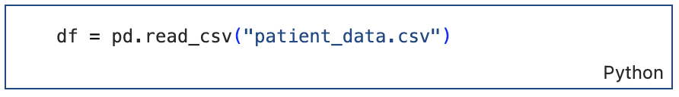
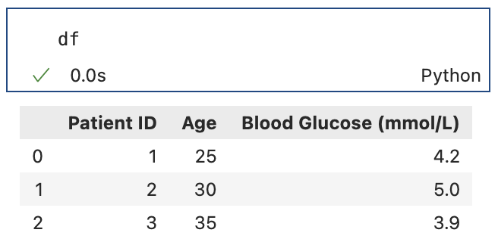
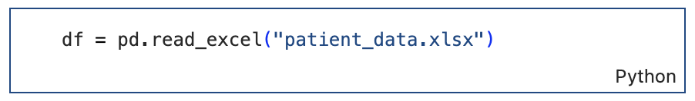
Basics of Pandas
Data structures in pandas:
DataFrame: 2D labeled data structure (like a table)
Series: 1D labeled array (like a single column in a table)​
You can create a pandas DataFrame in several ways:​
From a dictionary:
Full file path here
From a file:
To view your DataFrame:
This is the most common way you will create a pandas DataFrame – raw data is often stored in csv or excel files.

Slide 5
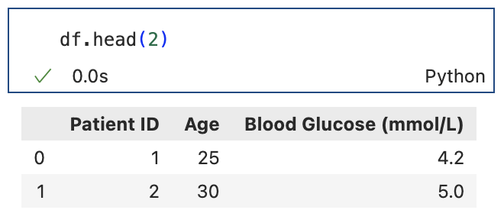
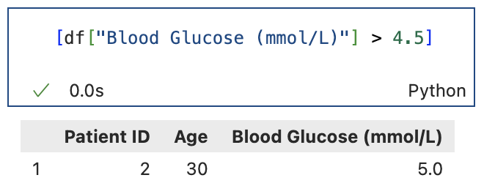
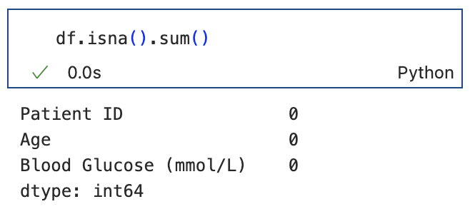
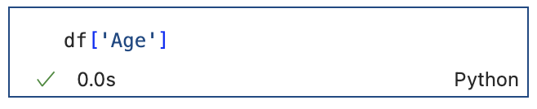
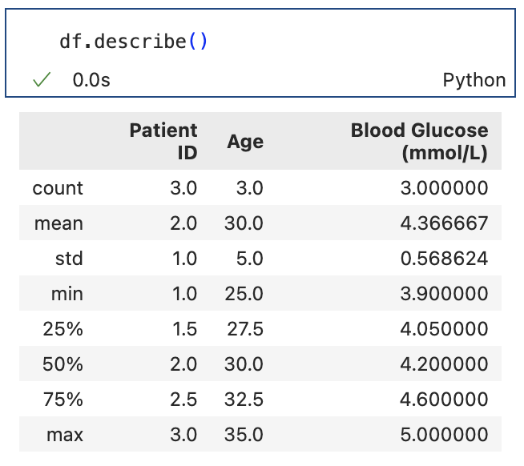
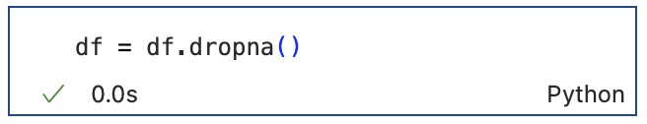
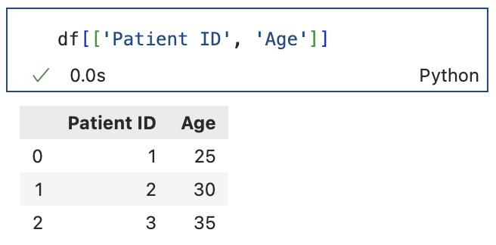
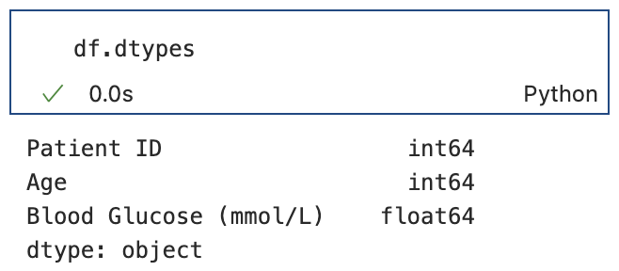
Key Pandas Functions & Methods
Print only the first few rows of your DataFrame (df):
How many missing values are in each column:
Filter rows:
Select a column:
Descriptive analysis of your df:
Drop all rows with missing values:
Print only select columns:
Print data types for each column:
Notes:
Talk about the inplace=True thing

Slide 6
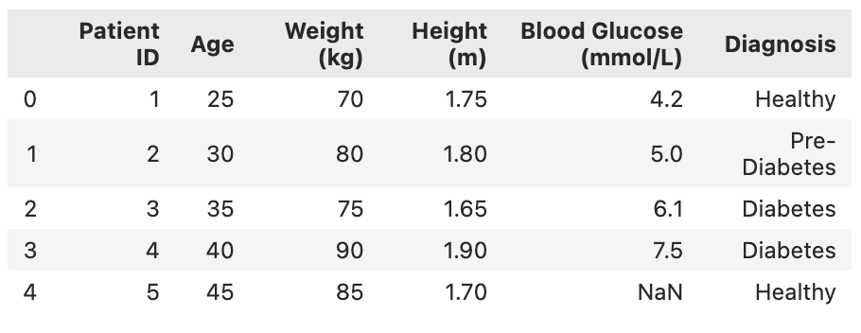
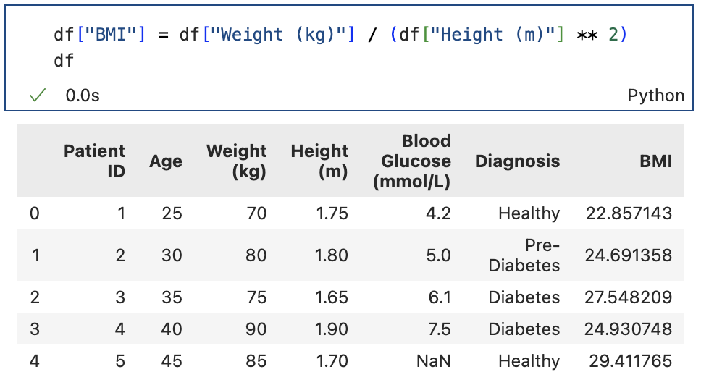
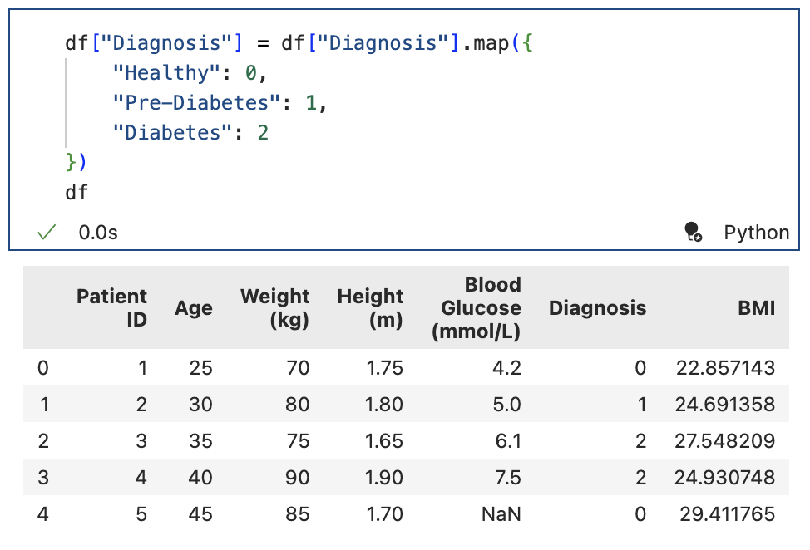
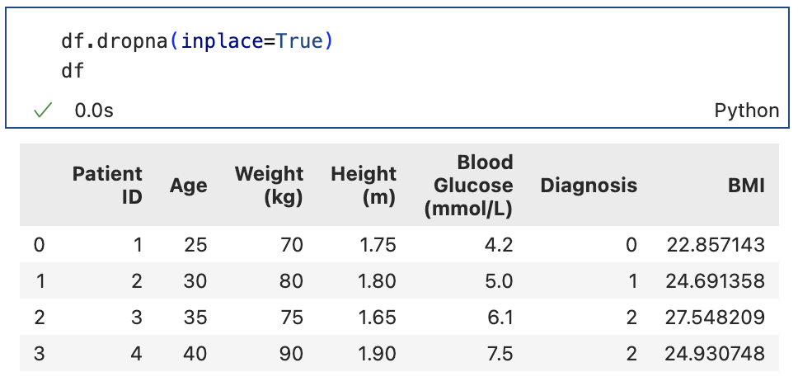
Pandas in Machine Learning
Example DataFrame:
Create a new column based on existing columns:
Integer encode a categorical column using a dictionary:
Drop rows with missing values:

Slide 7
You are given patient data in a dictionary format:
data = {
"Patient ID": [1, 2, 3, 4, 5, 6, 7],
"Age": [32, 45, 29, 56, 40, 35, 50],
"Cholesterol (mmol/L)": [5.2, 6.8, None, 7.1, 5.8, 5.9, None],
"Blood Pressure (mmHg)": [120, 140, 110, 160, 130, 125, 150],
"Smoker": ["No", "Yes", "No", "Yes", "No", "No", "Yes"],
"Cardiovascular Risk": ["Low", "High", "Low", "High", "Medium", "Medium", "High"]
}
Create a DataFrame from the dictionary
Drop all rows with missing values in them
Create a "Health Risk Score" column using the function: 0.4 x Cholesterol (mmol/L) + 0.6 x Blood Pressure (mmHg)
Conver the smoker column to binary: (Yes=1, No=0)
Challenge Yourself

Slide 8
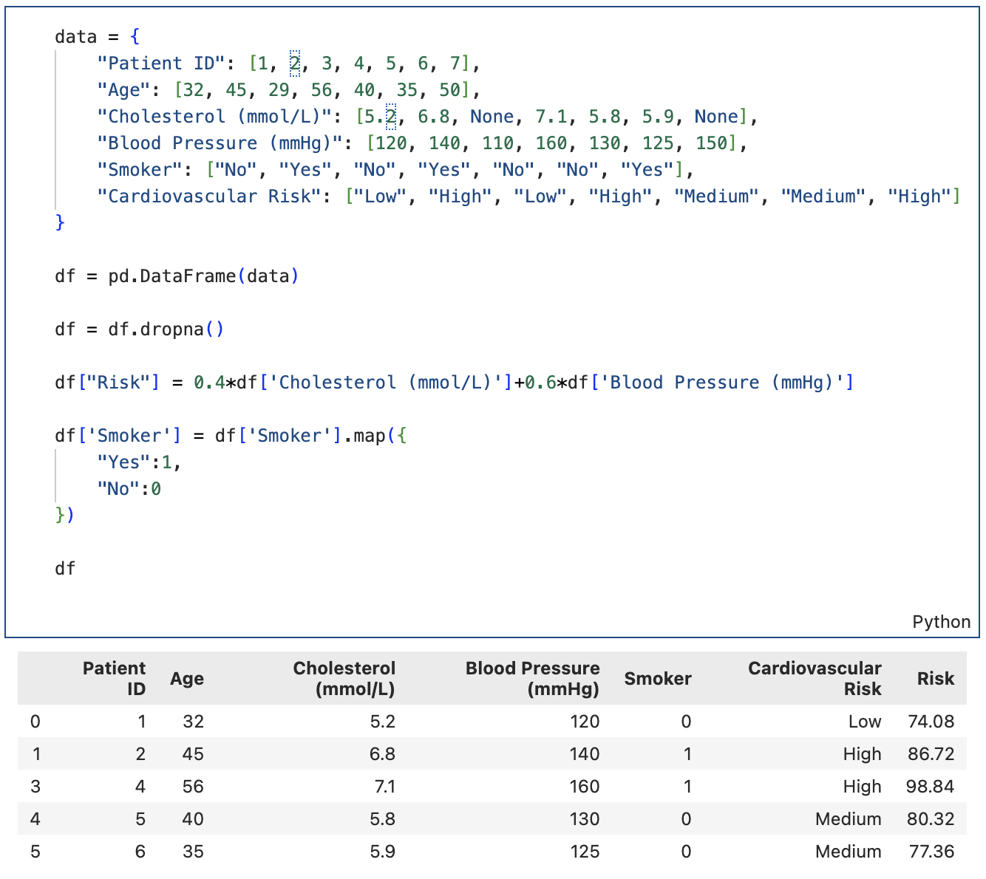

a.
b.
c.
d.

